Slide 1
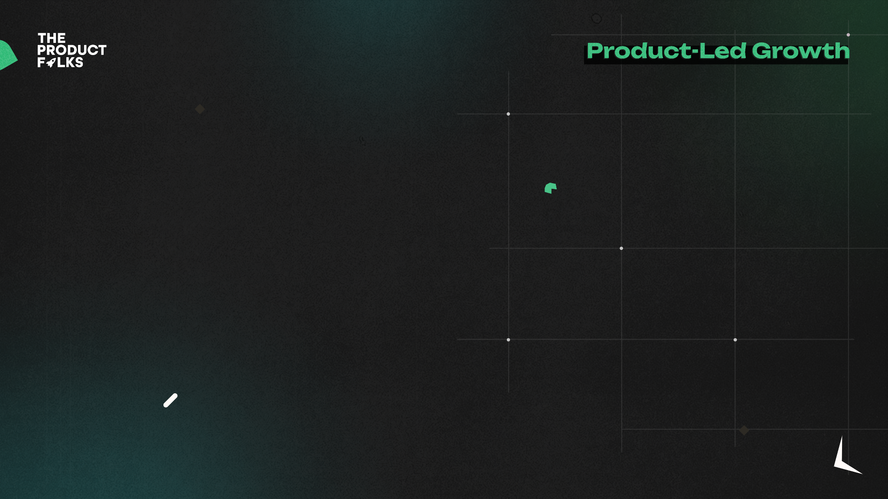


Assignment 1
Intent Framework & User Flows
Name: Raksha Pahariya
Email id: rakshapahariya1208@gmail.com
Role, Company: Student , IIEST Shibpur
Notes:
<Speaker Note>

Slide 2
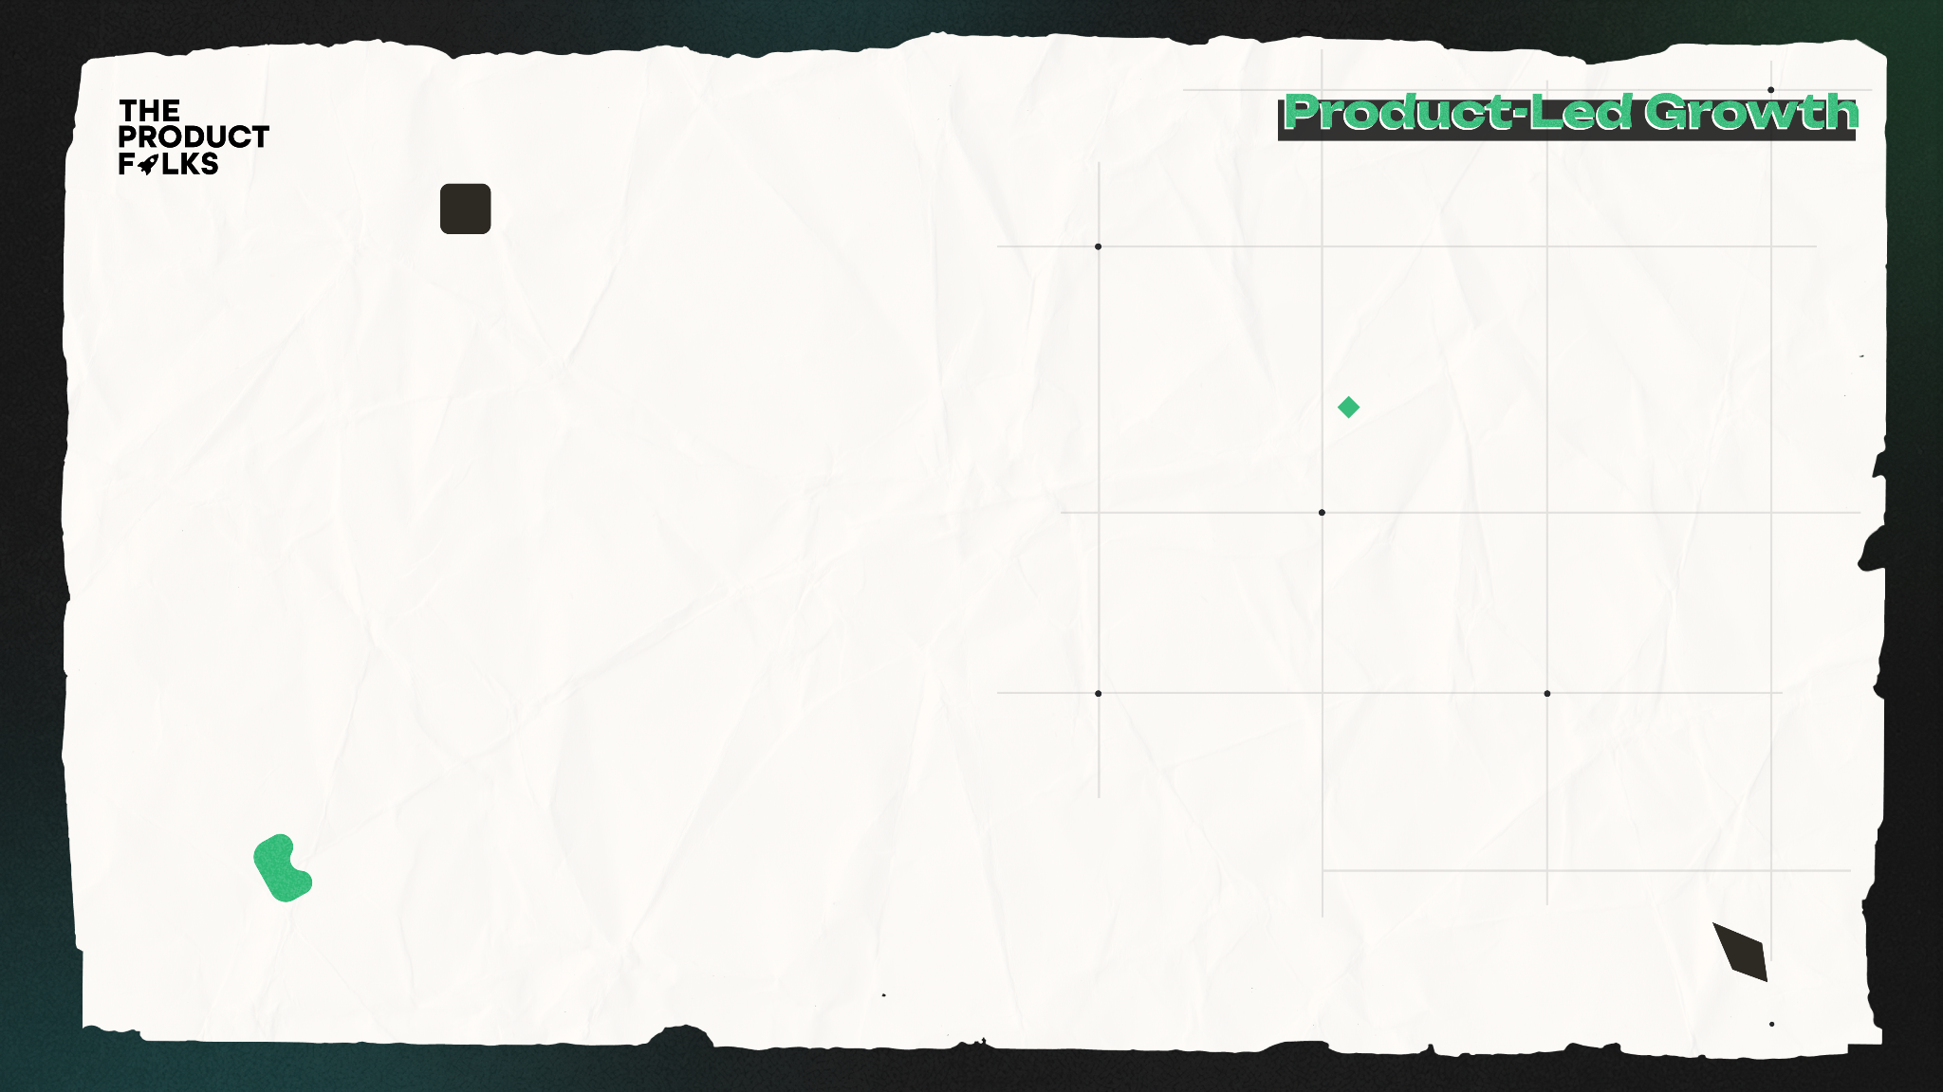
Problem Statement
The objective of this case study is to clearly articulate and understand the use of 4 part intent framework.
Define at least 2 user flows (each >3 steps) for the product and differentiate between the specific needs, intents of users during each of those steps.
Design new processes/actions using the above insights to develop new user flows that optimize for users completing the entire flow
PS: If you believe the current flows are already perfect, describe how the current flow accurately serves the user intent at each step.

Slide 3
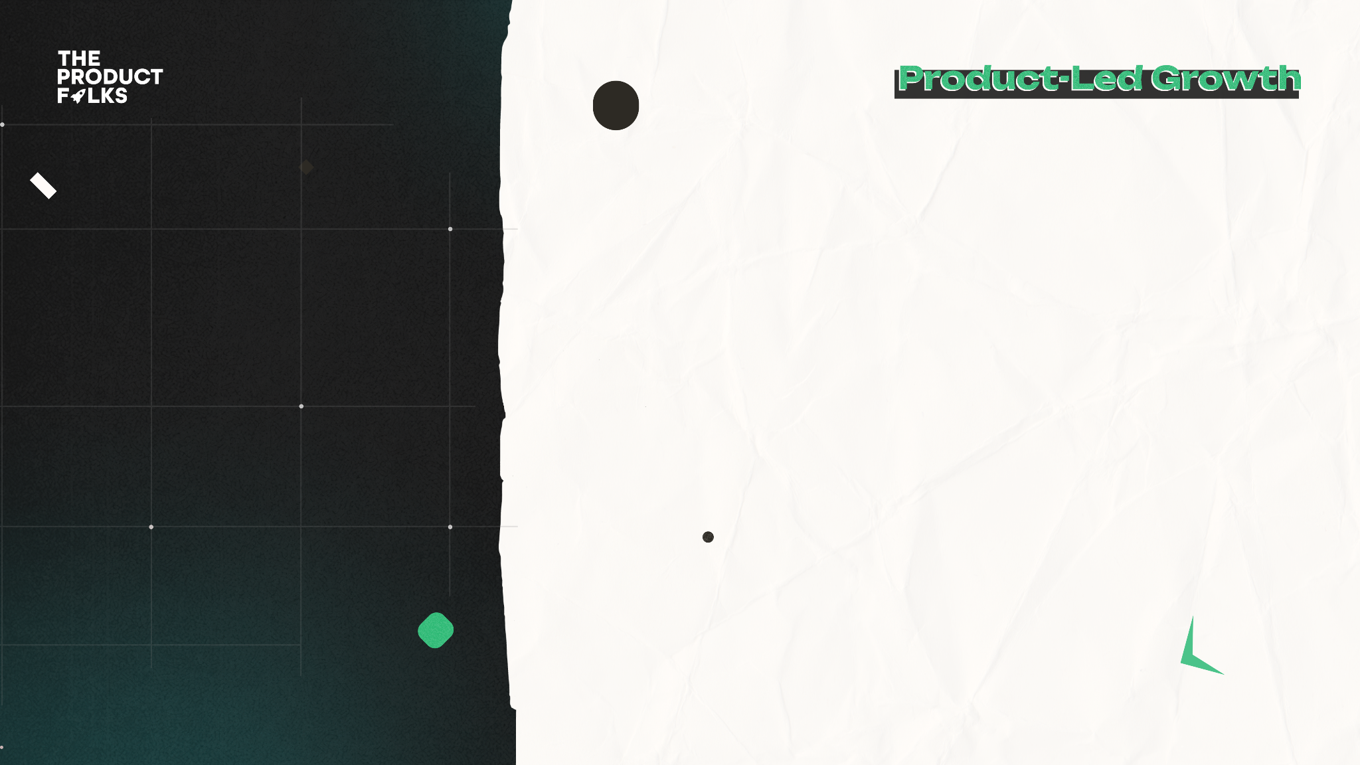
Background
Intent Framework
Existing User Flows
Optimised Flows
Metrics/Impact
Contents

Slide 4
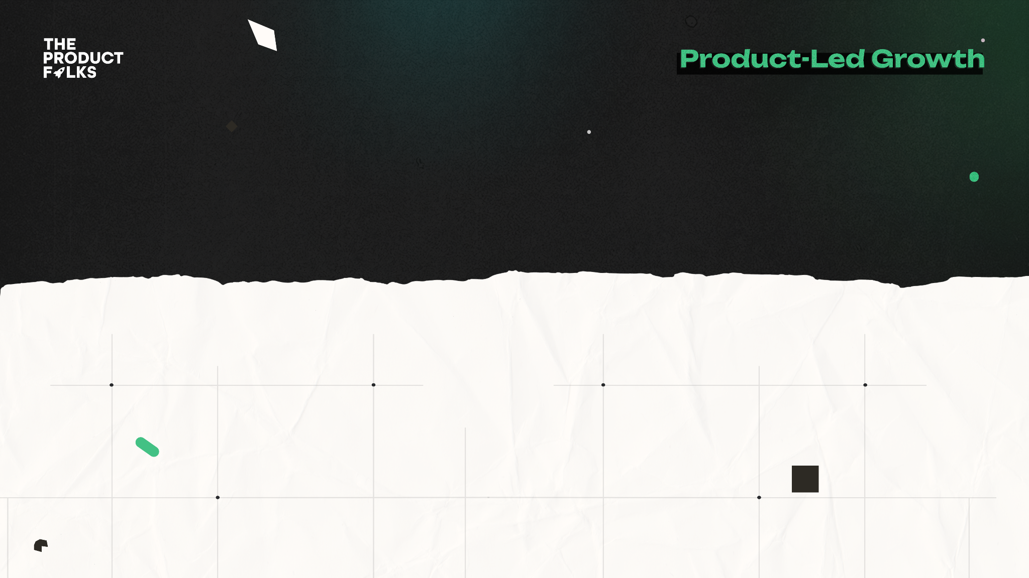
Background
Mention and describe the product you have picked
I have picked Amazon Prime Video as the product for this case study.A video streaming service called Amazon Prime Video delivers films, TV series, and Amazon Originals. It is a feature of the Amazon Prime membership, which also gives members access to Prime Music and Prime Reading as well as free shipping on qualifying purchases. Including smartphones, tablets, smart TVs, and gaming consoles, Amazon Prime Video is accessible on many different platforms and in more than 200 countries. The portal provides a combination of well-known films, vintage films, and original content, and new films are frequently added. In addition, Amazon Prime Video offers parental controls to limit access to particular content and lets users download content for offline watching.

Slide 5
The 4 Part Intent Framework is a methodology used to understand the user's intent and optimize user flows to maximize conversion rates. The framework involves creating, acquiring, shaping, and serving the user's needs.
1. Create: In the "Create" phase, the user intends to create something, whether it is a profile, a playlist, or a watchlist. The user's intent here is to establish a starting point for their streaming experience. The user should be able to easily create their profile, customize their watchlist, and set up preferences that will inform their experience on the platform.
2. Acquire: In the "Acquire" phase, the user intends to find something specific, whether it is a movie or TV show to watch or a channel to follow. The user's intent here is to search for something they want to consume. The platform should provide an intuitive search experience, with filters and recommendations that help the user find exactly what they are looking for.
Intent framework

Slide 6
3. Shape: In the "Shape" phase, the user intends to tailor their experience, whether it is by rating titles, setting preferences, or receiving recommendations. The user's intent here is to refine their streaming experience to match their taste and preferences. The platform should offer personalized recommendations, allow the user to rate titles, and provide easy access to settings that will shape their experience.
4. Serve: In the "Serve" phase, the user intends to consume content, whether it is watching a movie, binge-watching a TV show, or streaming live events. The user's intent here is to enjoy the content they have selected. The platform should provide a seamless streaming experience, with high-quality video and audio, subtitles, and the ability to easily navigate between episodes or movies.
(By understanding the user's intent in each phase of the streaming experience, the platform can optimize user flows and increase conversion rates. )
Intent framework

Slide 7
Existing User Flow
User Flow 1
User Flow 2

Slide 8
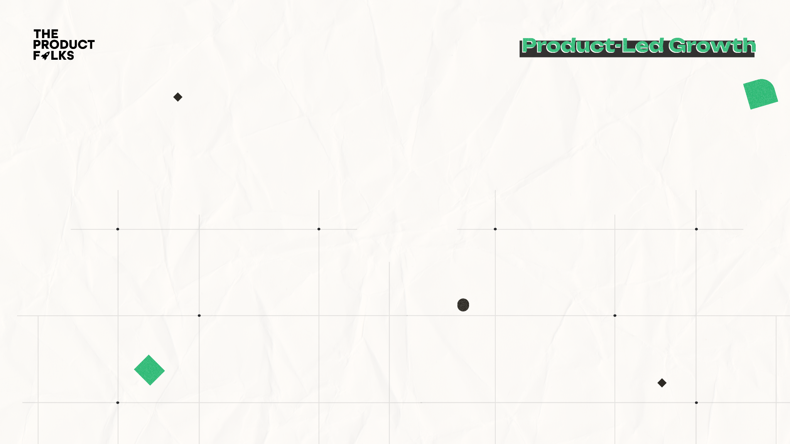
User Flow 1: Searching and Viewing a Film
When a user logs into Amazon Prime Video, the home screen is displayed.
The user chooses the "Movies" category after perusing the other categories.
The user chooses a movie to view from the list of available films by scrolling through it.
The user is shown a page with the synopsis, cast, and reviews of the film.
The "Watch Now" button is clicked by the user to begin streaming the film.
A loading screen is displayed to the user before the movie playback screen appears.
The controls allow the user to pause, rewind, or fast-forward while watching the movie.

Slide 9
User Flow 2: Searching for a TV Show and Adding it to Watchlist
When a user logs into Amazon Prime Video, the home screen is displayed.
The user enters the name of the TV show they wish to watch after clicking the search icon.
The user gets shown the search results, which also include the TV programme they were looking for.
The user clicks on the television programme to get its details page.
The user decides to add the show to their Watchlist after reading the summary, cast bio, and reviews.
When the user presses the "Add to Watchlist" button, a confirmation message appears.
To view their list of recorded TV series and films, the user clicks on the "Watchlist" button.
The user can now access the recently added TV show whenever they want after seeing it in their Watchlist.

Slide 10
Optimized
User Flow
User Flow 1
User Flow 2

Slide 11
Optimized User Flow 1: Browsing and Watching a Movie
User logs in to Amazon Prime Video and is presented with a personalized home screen based on their viewing history and preferences.
User is presented with a curated list of recommended movies based on their past viewing history and preferences.
User clicks on a movie and is presented with a trailer, the rating, and the number of people who watched it.
User can swipe left or right to see more recommended movies or search for a specific movie by title.
User clicks on the "Watch Now" button to start streaming the movie.
User is presented with a seamless loading experience with no delays.
User can start watching the movie without any interruption or buffering.
User can easily access the movie controls by swiping up or down on their screen to pause, rewind, or fast-forward.

Slide 12
Optimized User Flow 2: Searching for a TV Show and Adding it to Watchlist
User logs in to Amazon Prime Video and is presented with a personalized home screen based on their viewing history and preferences.
User clicks on the search icon and enters the name of a TV show they want to watch.
User is presented with the search results, which includes the TV show they searched for as well as similar titles based on their past viewing history and preferences.
User clicks on the TV show to view its details page and is presented with a trailer, the rating, and the number of people who watched it.
User reviews the show's synopsis, cast, and reviews, and decides to add it to their Watchlist.
User is presented with a confirmation message that the TV show has been added to their Watchlist and can continue browsing or watching other titles.
User can easily access their Watchlist from the home screen or the navigation menu and view all their saved titles in one place.
User can sort or filter their Watchlist based on their preferences and easily remove any title they no longer want to watch.

Slide 13
Briefly (in less than 400 words) describe how you would execute these solutions with your team. Feel free to include your assumptions (such as team details) if you think that's important.
I would first compile all the essential information on user behaviour, user feedback, and user pain areas before implementing these solutions with my team. This would entail gathering information from current user flows, doing user research, and identifying any potential conversion obstacles or roadblocks.
I would then collaborate with my team to create a thorough implementation plan for the new, improved user flows. This would entail determining the precise modifications that must be done and prioritising them in accordance with their likelihood of success and potential impact.

Slide 14
We would start working on putting these improvements into action as soon as we had a clear roadmap in place. In order to accomplish this, we would have to work closely with our design and development teams to make sure that all modifications are well-tested and executed before being made available to users.
I would also place a high priority on teamwork and communication during this process. To make sure that everyone is on the same page and working towards the same objectives, this would entail periodically exchanging reports on progress and asking team members for comments.
Assuming my team consists of designers, engineers, and product managers, I would make use of their knowledge to make sure we can successfully implement these improvements. Assumedly, we have access to the information and tools required to carry out user research and examine user behaviour.
As a whole, my strategy would be to place a high priority on teamwork, data-driven decision-making, and user-centric design to make sure we can implement these changes successfully and optimise user flows for maximum conversion.

Slide 15
Thank You!

